Slide 1
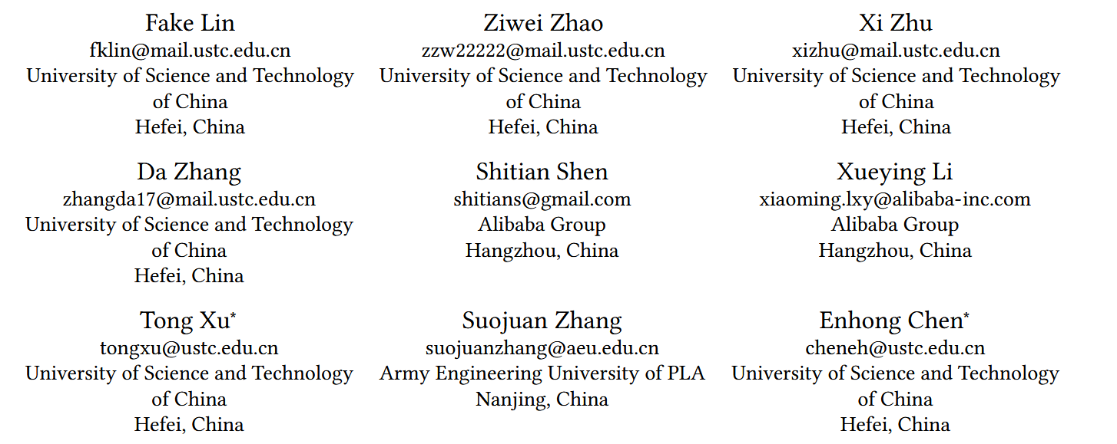
ATAI
Advanced Technique of Artificial Intelligence
ATAI
ChongqingUniversity _{AdvancedTechniqueof}
of Technology Artificial Intelligence
Chongqing University of
Technology
Chongqing University ^{ATAI}
_{of Technology} Advanced Techniqueof
Artificial Intelligence
Chongqing University of Technology
Chongqing University of Technology
When Box Meets Graph Neural Network in Tag-aware Recommendation
https://github.com/critical88/BoxGNN
——KDD_2024
Reported by Jingbo Liu
1

Slide 2
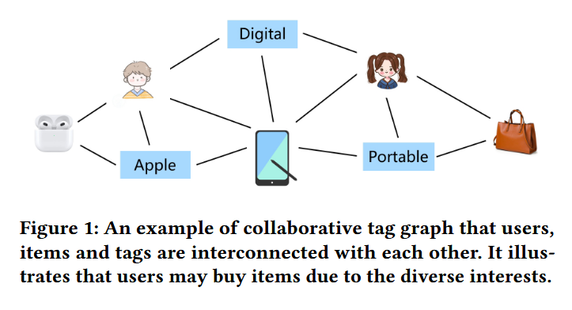
ATAI
Advanced Technique of Artificial Intelligence
ATAI
ChongqingUniversity _{AdvancedTechniqueof}
of Technology Artificial Intelligence
Chongqing University of
Technology
Chongqing University ^{ATAI}
_{of Technology} Advanced Techniqueof
Artificial Intelligence
Chongqing University of Technology
Chongqing University of Technology
Motive
1.Unfortunately, though large efforts have been made, current solutions may fail to describe the diversity and uncertainty inherent in user preferences with only tag-driven profiles.

Slide 3
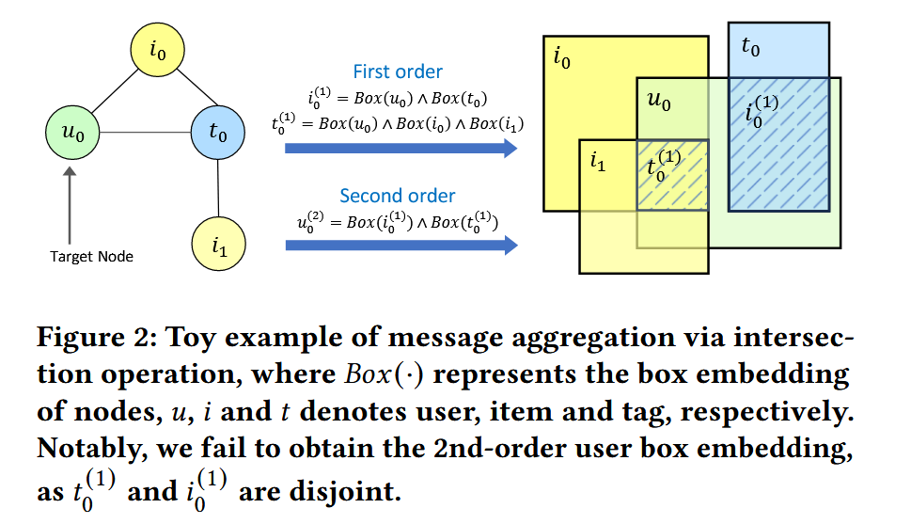
ATAI
Advanced Technique of Artificial Intelligence
ATAI
ChongqingUniversity _{AdvancedTechniqueof}
of Technology Artificial Intelligence
Chongqing University of
Technology
Chongqing University ^{ATAI}
_{of Technology} Advanced Techniqueof
Artificial Intelligence
Chongqing University of Technology
Chongqing University of Technology
Motive
2.However, defect still exists as these approaches are incapable of capturing high-order neighbor signals, i.e., semantic-rich multi-hop relations within the user-tag-item tripartite graph, which severely limits the effectiveness of user modeling.

Slide 4
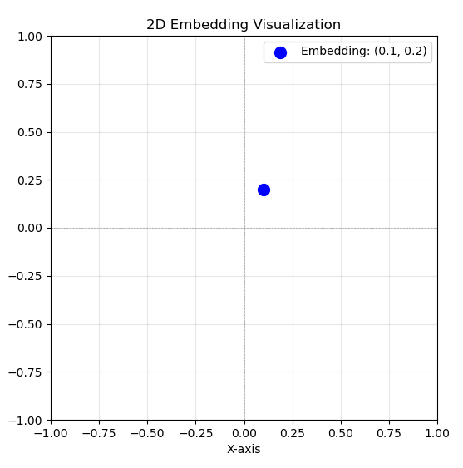
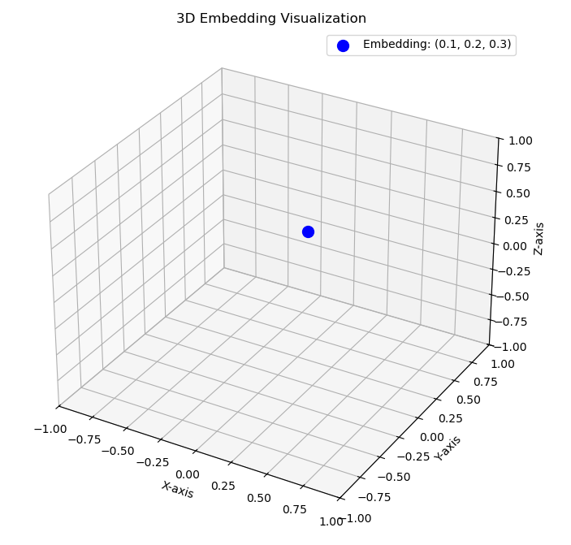
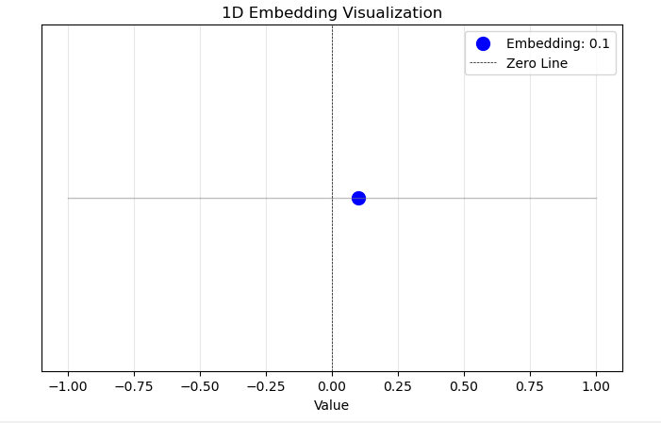
ATAI
Advanced Technique of Artificial Intelligence
ATAI
ChongqingUniversity _{AdvancedTechniqueof}
of Technology Artificial Intelligence
Chongqing University of
Technology
Chongqing University ^{ATAI}
_{of Technology} Advanced Techniqueof
Artificial Intelligence
Chongqing University of Technology
Chongqing University of Technology
Motive
embedding = [0.1]
embedding = [0.1,0.2]
embedding = [0.1,0.2,0.3]
多维embedding = [0.1,0.2,0.3,0.4,0.5]

Slide 5
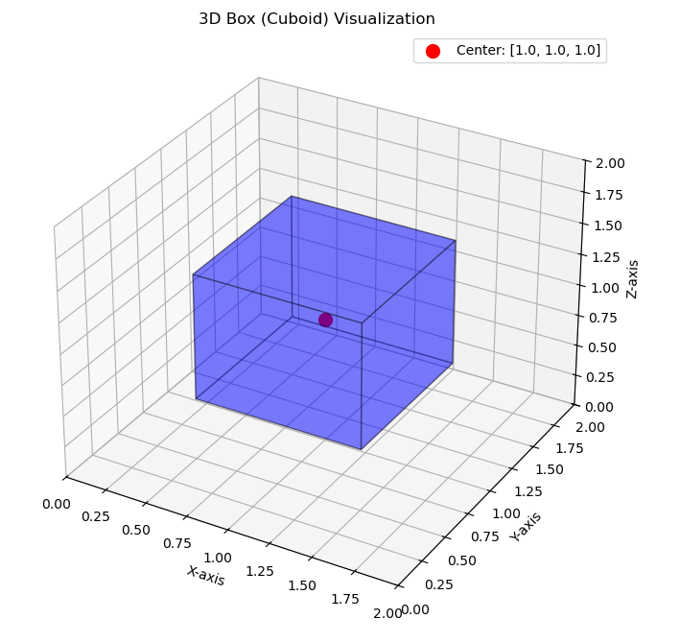
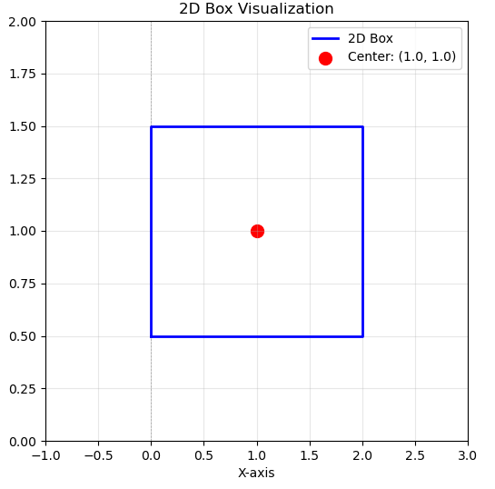
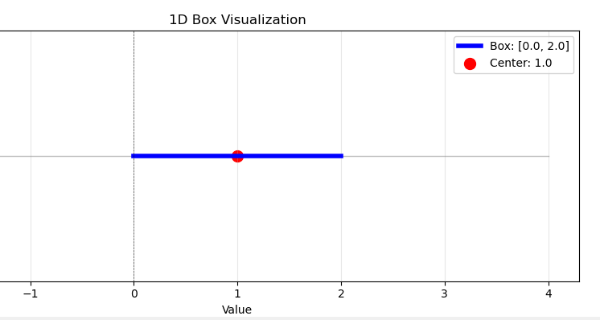
ATAI
Advanced Technique of Artificial Intelligence
ATAI
ChongqingUniversity _{AdvancedTechniqueof}
of Technology Artificial Intelligence
Chongqing University of
Technology
Chongqing University ^{ATAI}
_{of Technology} Advanced Techniqueof
Artificial Intelligence
Chongqing University of Technology
Chongqing University of Technology
Motive
center = [1.0, 1.0]
offset = [1.0, 0.5]
center = [1.0, 1.0, 1.0]
offset = [0.5, 0.5, 0.5]
center=[1.0]
offset=[1.0]
高维box
center = [1.0, 1.0, 1.0,1.0,1.0]
offset = [0.5, 0.5, 0.5,0.5,0.5]

Slide 6
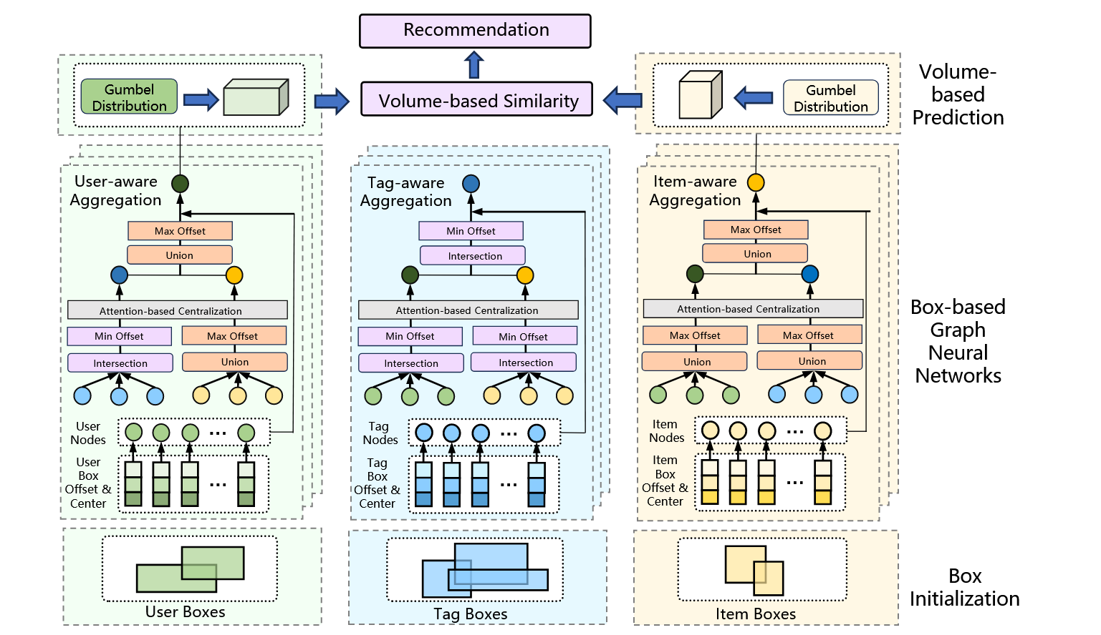
ATAI
ChongqingUniversity _{AdvancedTechniqueof}
of Technology Artificial Intelligence
Chongqing University of
Technology
ATAI
Advanced Technique of Artificial Intelligence
Chongqing University ^{ATAI}
_{of Technology} Advanced Techniqueof
Artificial Intelligence
Chongqing University of Technology
Chongqing University of Technology
Method

Slide 7
ATAI
ChongqingUniversity _{AdvancedTechniqueof}
of Technology Artificial Intelligence
Chongqing University of
Technology
ATAI
Advanced Technique of Artificial Intelligence
Chongqing University ^{ATAI}
_{of Technology} Advanced Techniqueof
Artificial Intelligence
Chongqing University of Technology
Chongqing University of Technology
Method

Slide 8
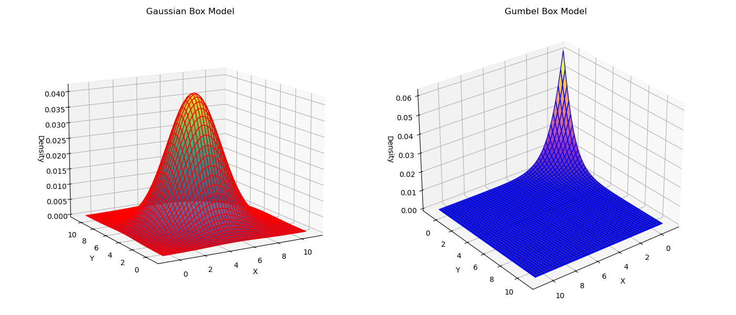
ATAI
Advanced Technique of Artificial Intelligence
ATAI
ChongqingUniversity _{AdvancedTechniqueof}
of Technology Artificial Intelligence
Chongqing University of
Technology
Chongqing University ^{ATAI}
_{of Technology} Advanced Techniqueof
Artificial Intelligence
Chongqing University of Technology
Chongqing University of Technology
Method

Slide 9
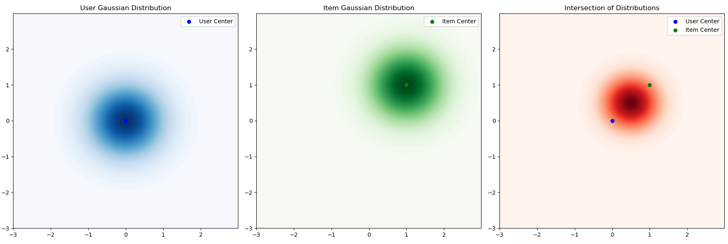
ATAI
Advanced Technique of Artificial Intelligence
ATAI
ChongqingUniversity _{AdvancedTechniqueof}
of Technology Artificial Intelligence
Chongqing University of
Technology
Chongqing University ^{ATAI}
_{of Technology} Advanced Techniqueof
Artificial Intelligence
Chongqing University of Technology
Chongqing University of Technology
Method

Slide 10
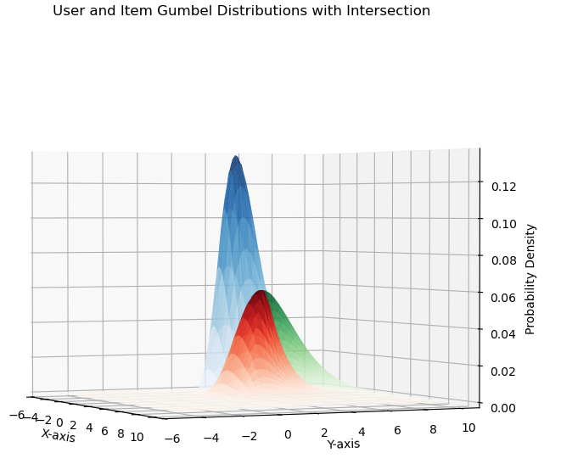
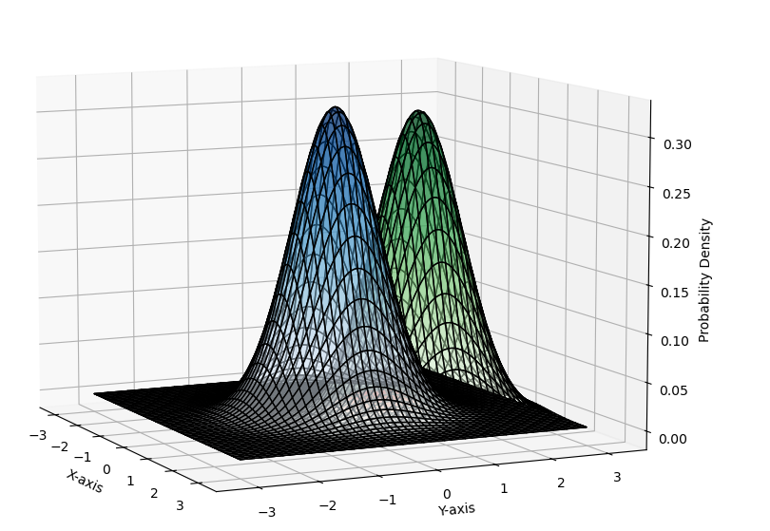
ATAI
Advanced Technique of Artificial Intelligence
ATAI
ChongqingUniversity _{AdvancedTechniqueof}
of Technology Artificial Intelligence
Chongqing University of
Technology
Chongqing University ^{ATAI}
_{of Technology} Advanced Techniqueof
Artificial Intelligence
Chongqing University of Technology
Chongqing University of Technology
Method

Slide 11
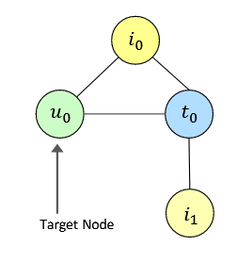
ATAI
Advanced Technique of Artificial Intelligence
ATAI
ChongqingUniversity _{AdvancedTechniqueof}
of Technology Artificial Intelligence
Chongqing University of
Technology
Chongqing University ^{ATAI}
_{of Technology} Advanced Techniqueof
Artificial Intelligence
Chongqing University of Technology
Chongqing University of Technology
Method

Slide 12
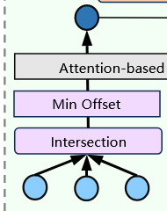
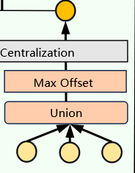
ATAI
Advanced Technique of Artificial Intelligence
ATAI
ChongqingUniversity _{AdvancedTechniqueof}
of Technology Artificial Intelligence
Chongqing University of
Technology
Chongqing University ^{ATAI}
_{of Technology} Advanced Techniqueof
Artificial Intelligence
Chongqing University of Technology
Chongqing University of Technology
Method

Slide 13
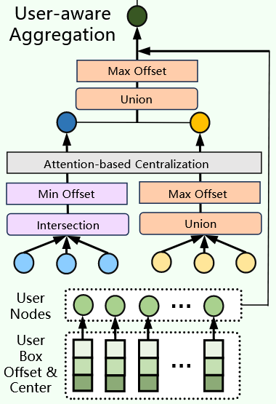
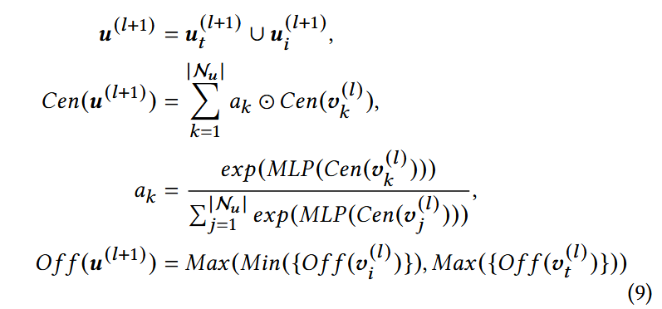
ATAI
Advanced Technique of Artificial Intelligence
ATAI
ChongqingUniversity _{AdvancedTechniqueof}
of Technology Artificial Intelligence
Chongqing University of
Technology
Chongqing University ^{ATAI}
_{of Technology} Advanced Techniqueof
Artificial Intelligence
Chongqing University of Technology
Chongqing University of Technology
Method

Slide 14
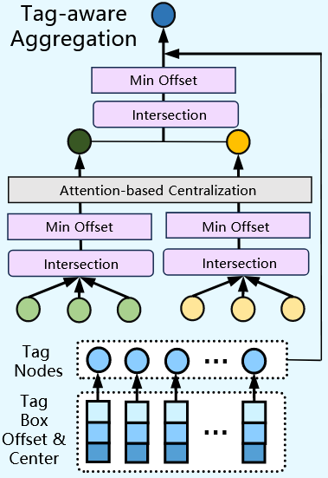
ATAI
Advanced Technique of Artificial Intelligence
ATAI
ChongqingUniversity _{AdvancedTechniqueof}
of Technology Artificial Intelligence
Chongqing University of
Technology
Chongqing University ^{ATAI}
_{of Technology} Advanced Techniqueof
Artificial Intelligence
Chongqing University of Technology
Chongqing University of Technology
Method

Slide 15
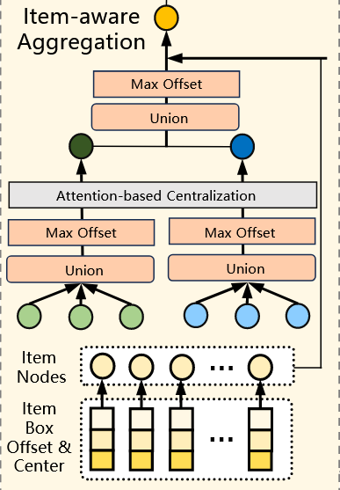
ATAI
Advanced Technique of Artificial Intelligence
ATAI
ChongqingUniversity _{AdvancedTechniqueof}
of Technology Artificial Intelligence
Chongqing University of
Technology
Chongqing University ^{ATAI}
_{of Technology} Advanced Techniqueof
Artificial Intelligence
Chongqing University of Technology
Chongqing University of Technology
Method

Slide 16
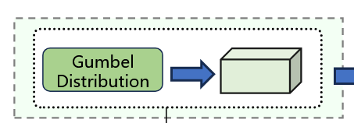
ATAI
Advanced Technique of Artificial Intelligence
ATAI
ChongqingUniversity _{AdvancedTechniqueof}
of Technology Artificial Intelligence
Chongqing University of
Technology
Chongqing University ^{ATAI}
_{of Technology} Advanced Techniqueof
Artificial Intelligence
Chongqing University of Technology
Chongqing University of Technology
Method

Slide 17
ATAI
Advanced Technique of Artificial Intelligence
ATAI
ChongqingUniversity _{AdvancedTechniqueof}
of Technology Artificial Intelligence
Chongqing University of
Technology
Chongqing University ^{ATAI}
_{of Technology} Advanced Techniqueof
Artificial Intelligence
Chongqing University of Technology
Chongqing University of Technology
Method

Slide 18
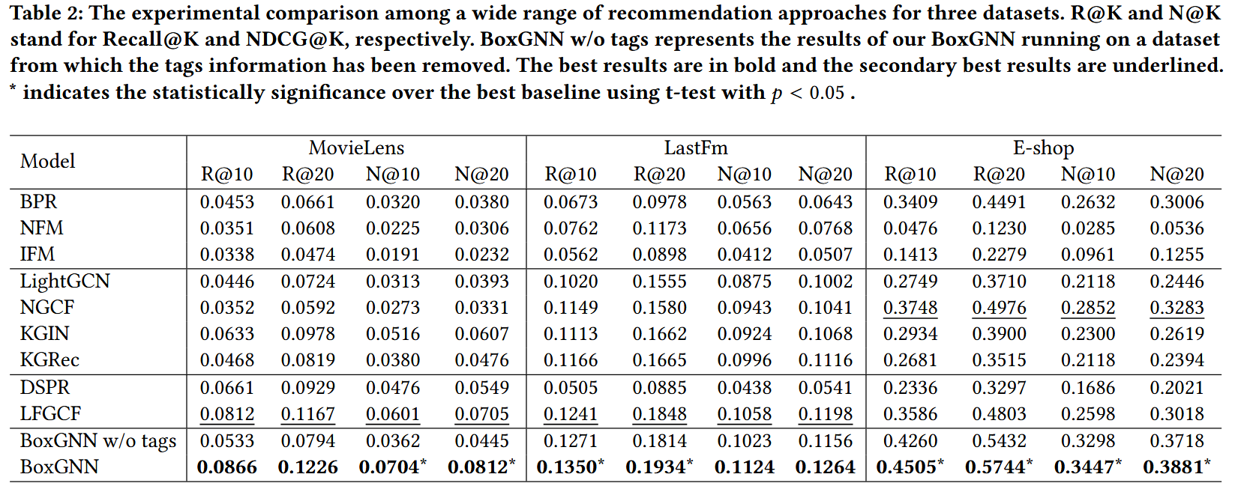
ATAI
Advanced Technique of Artificial Intelligence
ATAI
ChongqingUniversity _{AdvancedTechniqueof}
of Technology Artificial Intelligence
Chongqing University of
Technology
Chongqing University ^{ATAI}
_{of Technology} Advanced Techniqueof
Artificial Intelligence
Chongqing University of Technology
Chongqing University of Technology
Experiments

Slide 19
ATAI
Advanced Technique of Artificial Intelligence
ATAI
ChongqingUniversity _{AdvancedTechniqueof}
of Technology Artificial Intelligence
Chongqing University of
Technology
Chongqing University ^{ATAI}
_{of Technology} Advanced Techniqueof
Artificial Intelligence
Chongqing University of Technology
Chongqing University of Technology
Experiments

Slide 20
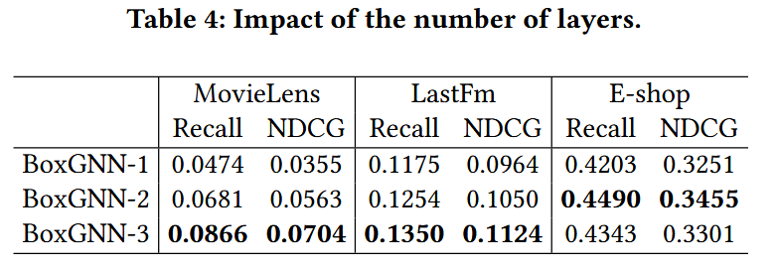
ATAI
Advanced Technique of Artificial Intelligence
ATAI
ChongqingUniversity _{AdvancedTechniqueof}
of Technology Artificial Intelligence
Chongqing University of
Technology
Chongqing University ^{ATAI}
_{of Technology} Advanced Techniqueof
Artificial Intelligence
Chongqing University of Technology
Chongqing University of Technology
Experiments

Slide 21
ATAI
Advanced Technique of Artificial Intelligence
ATAI
ChongqingUniversity _{AdvancedTechniqueof}
of Technology Artificial Intelligence
Chongqing University of
Technology
Chongqing University ^{ATAI}
_{of Technology} Advanced Techniqueof
Artificial Intelligence
Chongqing University of Technology
Chongqing University of Technology
Experiments

Slide 22
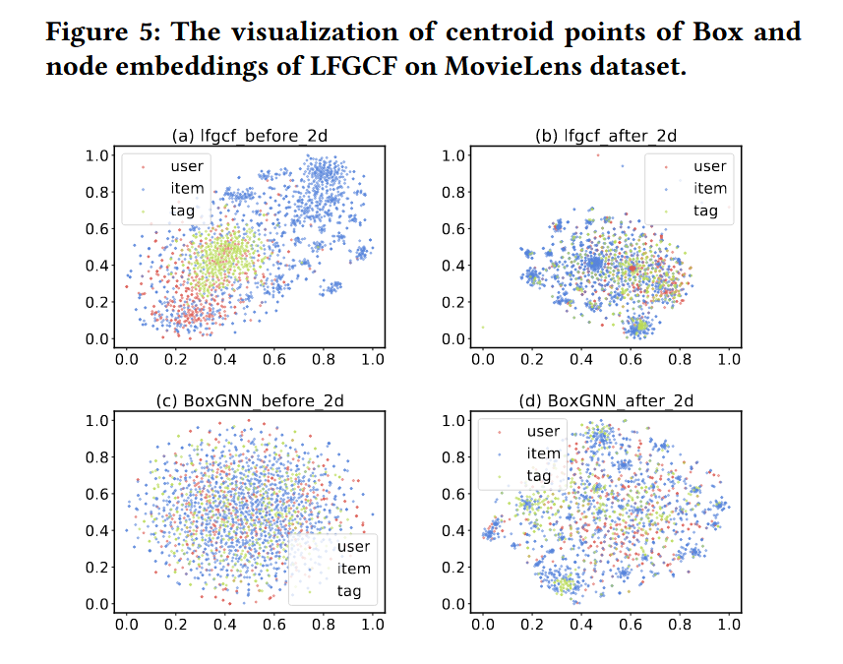
ATAI
Advanced Technique of Artificial Intelligence
ATAI
ChongqingUniversity _{AdvancedTechniqueof}
of Technology Artificial Intelligence
Chongqing University of
Technology
Chongqing University ^{ATAI}
_{of Technology} Advanced Techniqueof
Artificial Intelligence
Chongqing University of Technology
Chongqing University of Technology
Experiments

Slide 23
ATAI
Advanced Technique of Artificial Intelligence
ATAI
ChongqingUniversity _{AdvancedTechniqueof}
of Technology Artificial Intelligence
Chongqing University of
Technology
Chongqing University ^{ATAI}
_{of Technology} Advanced Techniqueof
Artificial Intelligence
Chongqing University of Technology
Chongqing University of Technology
Thanks!

